Slide 1
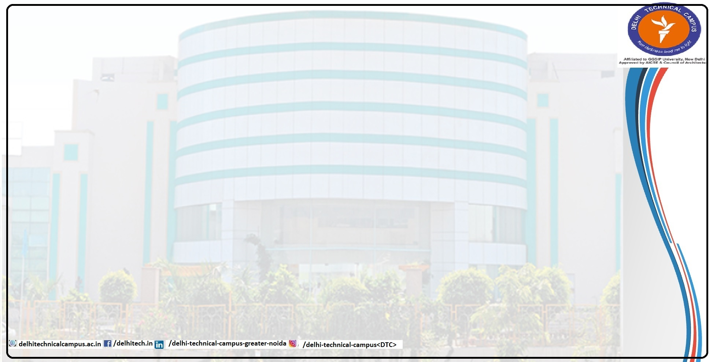
UNIT -II
POINTERS
Prepared By:
Dr. Archana Sharma
archana@delhitechnicalcampus.ac.in

Slide 2
POINTER
Pointer is a variable that stores the address of another variable. A pointer in c is used to allocate memory dynamically at run time. The pointer variable might be belonging to any of the data type such as int, float, char, double, short etc.
Pointer syntax:
data_type*var_name;
Example:
int*p; char*p;

Slide 3
DECLARING POINTER VARIABLE
Pointers variables contain addresses that belong to a separate data type, they must be declared as pointers before we use them. The declaration of a pointer variable takes the following form
data_type * pt_name;

Slide 4
INITIALIZATION OF POINTER VARIABLE
Pointer initialization is the process of assigning address of a variable to pointer variable. Pointer variable contains address of variable of same data type. In c address operator & is used to determined the address of a variable. The & returns the address of the variable.
EXAMPLE:
int a=10;
int*ptr; ptr=&a; or
//pointer declaration
//pointer initialization
int*ptr=&a; //initialization and declaration together

Slide 5
EXAMPLE PROGRAM
#include <stdio.h> int main()
{
int *ptr, q; //declaration q=50;
output:
50
ptr = &q; //intialization
printf("%d", *ptr); //display q's value using ptr variable printf("%d", ptr);
return 0;
}

Slide 6

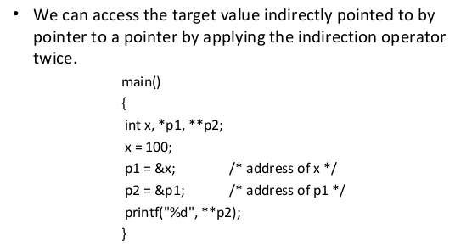
CHAIN OF POINTER
It is possible to make a pointer to point to another pointer, thus
creating a chain of pointers.

Slide 7
POINTER EXPRESSIONS
The pointer variable can be used in expressions. (eg) p1 and p2 are properly declared and initialized pointer, then the following statements are valid.
a=10;
p2=&a;
y = * p1 * *p2;
sum = sum + * p1;
* p2 = * p2 + 10;

Slide 8
QUIZ on POINTERS
Q1. In a C Program if
int a = 5;
Int *ptr = &a;
then the printf statement with
&a, a, *ptr , ptr
Q2 In a C program,
int a = 20,*ptr, **dptr;
ptr = &a;
dptr = &ptr;
printf ("%d", **dptr);
Q3. What will be the output of following code assuming that array begins at location 1002?
#include<stdio.h>
main()
{
int a[5] = {1, 2, 3, 4, 5};
int *p = a;
printf("%d\t%d\t%d\t%d\t",*p,0[a],a,p);
}

Slide 9

#include<stdio.h>
int main()
{
int arr[] = {10, 20, 30, 40, 50, 60};
int *ptr1 = arr;
int *ptr2 = arr + 5;
printf("Number of elements between two pointer are: %d.",
(ptr2 - ptr1));
printf("Number of bytes between two pointers are: %d",
(char*)ptr2 - (char*) ptr1);
return 0;
}

Slide 10
Assume that an int variable takes 4 bytes and a char variable takes 1 byte
Number of elements between two pointer are: 5. Number of bytes between two pointers are: 20
Number of elements between two pointer are: 20. Number of bytes between two pointers are: 20
Number of elements between two pointer are: 5. Number of bytes between two pointers are: 5
Compiler Error

Slide 11
RULES OF POINTER OPERATIONS
A pointer variable can be assigned the address of another variable.
A pointer variable can be assigned the values of pointer variable.
A pointer variable can be initialized with NULL
value.
or zero
A pointer variable can be pre-fixed or post-fixed with
increment or decrement operators.
An integer value may be added or subtracted from a pointer
variable.

Slide 12
Pointers and arrays
Array indexing: a[0], a[1], a[2], …
int *ip = &a[0];
Pointer indexing: *ip, *(ip+1), *(ip+2), …
In general a[i] is “equivalent” to *(ip+i)

Slide 13
Pointer Arithmetic
. What will be output of following program?
#include
#include
int main() {
int a = 5,b = 10,c;
int *p = &a,*q = &b;
c = p-q;
printf("%d",c);
return 0;
}

Slide 14
Ans. Output: 1
Because difference of two same type of pointer is always one.

Slide 15


int *ip;
int a[10];
ip = &a[3];
ip2 = ip + 1;
[http://www.eskimo.com/~scs/cclass/notes/sx10a.html]

Slide 16
#include <stdio.h>
const int MAX = 3;
int main () {
int var[] = {10, 100, 200};
int i, *ptr;
/* let us have address of the first element in pointer */
ptr = var;
i = 0;

Slide 17
while ( ptr <= &var[MAX - 1] ) {
printf("Address of var[%d] = %x\n", i, ptr );
printf("Value of var[%d] = %d\n", i, *ptr );
/* point to the next location */
ptr++;
i++;
}
return 0;
}

Slide 18
Autoincrement operator ++
(and its companion, --)
Both of these are defined for pointers
Array version: a[i++]
Pointer version: *ip++

Slide 19
Prefix form is defined too
Array version: a[++i]
preincrement form: *++ip
*ip-- and *--ip.

Slide 20
Copying an array using pointers
int array1[10], array2[10];
int *ip1, *ip2 = &array2[0];
int *ep = &array1[9];
for(ip1 = &array1[0]; ip1 <= ep; ip1++)
*ip2++ = *ip1;

Slide 21
Comparing strings using pointers
char *p1 = &str1[0], *p2 = &str2[0];
while(1)
{
if(*p1 != *p2)
return *p1 - *p2;
if(*p1 == '\0' || *p2 == '\0')
return 0;
p1++;
p2++;
}
[http://www.eskimo.com/~scs/cclass/notes/sx10a.html]

Slide 22
String copy using pointers
char *dp = &dest[0], *sp = &src[0];
while(*sp != '\0')
*dp++ = *sp++;
*dp = '\0';
[http://www.eskimo.com/~scs/cclass/notes/sx10a.html]

Slide 23
Arrays of pointers
#include <stdio.h>
#include <stdlib.h>
int main()
{
int* pArray[10];
int a;
int b;
pArray[0] = &a;
pArray[1] = &b;
system("pause");
}

Slide 24
ARRAY OF POINTER
#include <stdio.h> const int MAX = 3; int main ()
{
int var[] = {10, 100, 200};
int i, *ptr[MAX];
for ( i = 0; i < MAX; i++)
{
ptr[i] = &var[i]; /* assign the address of integer. */
}
for ( i = 0; i < MAX; i++)
{
printf("Value of var[%d] = %d\n", i, *ptr[i] );
}
return 0;
}
Output:
Value of var[0] = 10 Value of var[1] = 100 Value of var[2] = 200

Slide 25
POINTER AS FUNCTION ARGUMENTS
When we pass addresses to a function, the parameters receiving the addresses should be pointers. The process of calling a function using pointers to pass the addresses of variables is known as ’call by reference’
.
for example: main()
{
int *x;
*x=20;
change(&x); //call by reference or address
printf(“%d\n”,x);
}
change(int *p)
{
*p = *p + 10;
}

Slide 26
EXAMPLE PROGRAM
#include <stdio.h>
Void exchange(int *, int*); //prototype Value of a is 10
main()
{
int x,y; X=100; Y=200;
Printf(“Before exchange:x=%d y=%d”,x,y); exchange(&x,&y); //call
Printf(“After exchange:x=%d y=%d”,x,y);
}
Exchange(int*a,int*b)
{
int t;
t=*a; //assign the value at address a to t
*a=*b;
*b=t; return 0;
}
Output:
Before exchange: x=100 y=200
After exchange : x = 200 y = 100

Slide 27
What is (void*)0 ?
Ans. It’s a representation of the NULL pointer. It point the value of a pointer is zero. This
NULL Pointer is used to hide any information in C language program. Using this will prevent
the compiler from dereferencing. A program to show the use of this NULL Pointer is given
belowvoid abc(void *a, int b)
{
if(b==1)
printf("%d",*(int*)a); // If an integer pointer received
else if(b==2)
printf("%c",*(char*)a); // If a character pointer received
else if(b==3)
printf("%f",*(float*)a); // If a float pointer received
}
Q3. State the equi

Slide 28
Pointers in Ada
Some dangling pointers are disallowed because dynamic objects can be automatically deallocated at the end of pointer's type scope
The lost heap-dynamic variable problem is not eliminated by Ada (possible with UNCHECKED_DEALLOCATION)
1-<number>

Slide 29
Pointers in C and C++
Extremely flexible but must be used with care
Pointers can point at any variable regardless of when or where it was allocated
Used for dynamic storage management and addressing
Pointer arithmetic is possible
Explicit dereferencing and address-of operators
Domain type need not be fixed (void *)
void * can point to any type and can be type
checked (cannot be de-referenced)
1-<number>

Slide 30
Reference Types
C++ includes a special kind of pointer type called a reference type that is used primarily for formal parameters
  Advantages of both pass-by-reference and pass-by-value
Java extends C++’s reference variables and allows them to replace pointers entirely
  References are references to objects, rather than being addresses
C# includes both the references of Java and the pointers of C++
1-<number>

Slide 31
Evaluation of Pointers
Dangling pointers and dangling objects are problems as is heap management
Pointers are like goto's--they widen the range of cells that can be accessed by a variable
Pointers or references are necessary for dynamic data structures--so we can't design a language without them
1-<number>

Slide 32
Representations of Pointers
Large computers use single values
Intel microprocessors use segment and offset
1-<number>

Slide 33
Dangling Pointer Problem
Tombstone: extra heap cell that is a pointer to the heap-dynamic variable
  The actual pointer variable points only at tombstones
  When heap-dynamic variable de-allocated, tombstone remains but set to nil
  Costly in time and space
. Locks-and-keys: Pointer values are represented as (key, address) pairs
  Heap-dynamic variables are represented as variable plus cell for integer lock value
  When heap-dynamic variable allocated, lock value is created and placed in lock cell and key cell of pointer
1-<number>

Slide 34
Heap Management
A very complex run-time process
Single-size cells vs. variable-size cells
Two approaches to reclaim garbage
  Reference counters (eager approach): reclamation is gradual
  Mark-sweep (lazy approach): reclamation occurs when the list of variable space becomes empty
1-<number>

Slide 35
Reference Counter
Reference counters: maintain a counter in every cell that store the number of pointers currently pointing at the cell
  Disadvantages: space required, execution time required, complications for cells connected circularly
  Advantage: it is intrinsically incremental, so significant delays in the application execution are avoided
1-<number>

